Slide 1
CSE 140L
Lab 2 Assignment
Alarm Clock
1. Clock + Alarm
2. + Day of Week
3. + Date and Month

Slide 2
Part 1: Basic Alarm Clock
Behavioral Description
  User can adjust the clock time and the alarm time.
  A set of LCDs that display:
    The alarm time when the user is setting the alarm;
    The current time in all other cases.
  User can turn the alarm on or off.
  If the alarm is on, the buzzer goes high when
    clock hour = alarm hour, and
    clock minutes = alarm minutes.
-- Alarm works on weekdays only
-- For an A: add date and month calendar (365-day year only)

Slide 3
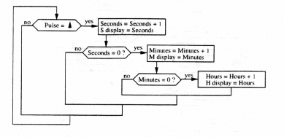
Clock Behavioral Diagram
Student to add day-of-wk cntr

Slide 4
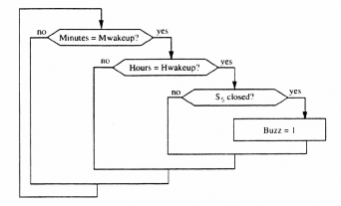
Alarm Behavioral Diagram
Student to add day-of-week alarm control.

Slide 5
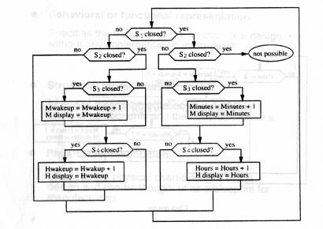
Combined Behavioral Diagram
Suggestion: Structural Diagram Is More Helpful

Slide 6
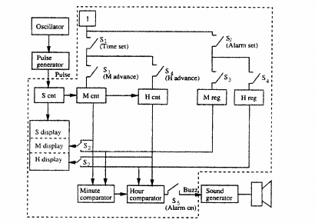
Structural Diagram
Use This -- Much Closer to Desired Design

Slide 7
Components Provided for Part 1
ct_mod_N (use 5 copies/instantiations):
  TimeSeconds: increment at each PULSE posedge when TimeSet = 0, as in a regular clock. It freezes/holds when TimeSet = 1.
  TimeMinutes: increment at each PULSE posedge when TimeSet=MinAdv=1 or when TimeSeconds = 59, otherwise holds.
  TimeHours: increment at each PULSE posedge when TimeSet=HrsAdv=1 or when TimeMinutes = TimeSeconds = 59, otherwise holds.
  AlarmMinutes: increment at each PULSE posedge only when AlarmSet=MinAdv=1, otherwise holds.
  AlarmHours: increment at each PULSE posedge only when AlarmSet=HrsAdv=1, otherwise holds.
lcd_int:
  Takes a 7-bit input number (0 to 127) and displays it on 7-segment displays as two decimal digits. In this design, only 6 bits are needed/used.
alarm:
  Dual 7-bit comparator that outputs a ‘1’ iff alarm_hours=time_hours and alarm_minutes=time_minutes
MUX-2x7 (for student to implement):
  dual 7-bit 2-to-1 multiplexer that selects two of the four 7-bit inputs and directs it to its dual 7-bit outputs.

Slide 8
Part 2: Days of the Week
Behavioral Description
  The alarm clock keeps track of the day of the week and displays it on a 7-seg LCD Display.
    Counts from 0 to 6 (each number represents a different day of the week, starting with 0 for the 7th day and going to 6 for the 6th day)
  Requires a new counter for tracking the day of the week for the current time and a new register for setting days off (no alarm).
  The day of the week for the alarm to go off can also be set.
    The alarm will now buzz when current hour = alarm hour, current minute = alarm minute, and current day != (alarm_day or alarm_day+1).
    The day of the week counter will count from 0 to 6.
    The alarm day counter can be set from 0 to 7. If 7, then the alarm is enabled every day. If 0 through 6, see next page.

Slide 9
Alarm Day of Week and Time Day of Week
Alarm Time | 0 | 1 | 2 | 3 | 4 | 5 | 6 | 7
0 | 0 | A | A | A | A | A | 0 | A
1 | 0 | 0 | A | A | A | A | A | A
2 | A | 0 | 0 | A | A | A | A | A
3 | A | A | 0 | 0 | A | A | A | A
4 | A | A | A | 0 | 0 | A | A | A
5 | A | A | A | A | 0 | 0 | A | A
6 | A | A | A | A | A | 0 | 0 | A
Thus, if Alarm_Day = 3 and Time_Day = 3 or 4,
alarm will not go off (0).

Slide 10
Part 3
Add a 4-digit calendar display (date and month) to the test bench and a date/month counter to the design
366-day (leap) year only –we have 29 Feb 2024 :)
Figure out how to map 366 consecutive days to date/month format or how to create a 29-30-31 day counter that responds to the month.
Tricky part: involves two interlocked counters
To make your life easier, assume the month is always set before the date, to avoid setting something like Feb 31.
You can try doing it with one mod 366 counter instead of a mod 12 and a mod 29-31, but you'll have to work out the mapping to the month and date set controls, displays, etc.

Slide 11
Components for Part 3
MonthofYear
Counts 1 through 12 (how, if ct_mod_N counts 0 through 11)?
Set/increment via TimeAdv=MonthAdv=1 or rollover from DayOfMonth
DayOfMonth – Represents day of month
– Again Based on ct_mod_N (or a special version thereof -- your choice)
– Months 1, 3, 5, 7, 8, 10, 12: count 1 to 31
– Months 4, 6, 9, 11: count 1 to 30
– Month 2: count from 1 to 29
– Can be incremented via TimeAdv=DateAdv=1 (independently of DayOfWeek) or through a rollover of the hours (in parallel with DayOfWeek).
– Always assume set after Month is being set

